Slide 1
State Space Model
and
Applications in Event Vision
Tuxun Lu

Slide 2
The Sequence Modeling Crisis
Sequence modeling is a machine learning technique for analyzing and predicting patterns in ordered data, where the sequence's order matters
We need to remember the past to predict the future(Long Range Dependencies)
Models are either easy to train but slow to infer, or fast to infer but hard to train

Slide 3
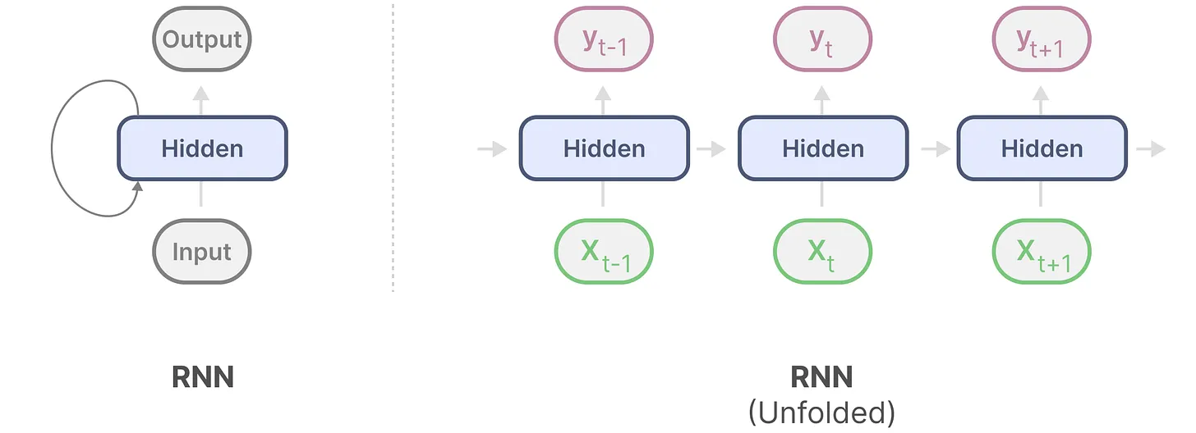
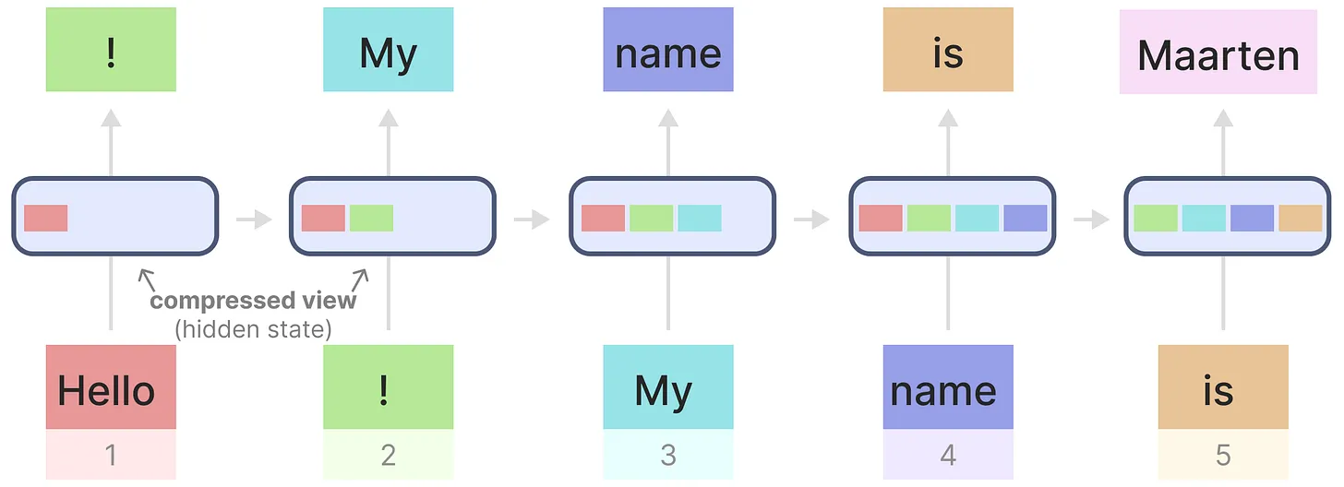
Recurrent Neural Networks (RNNs)
Easy Inference
Scales linearly with sequence length
No memory increase with context length
Hard to train
Cannot parallelize
Vanishing gradients, model forgets information over time

Slide 4
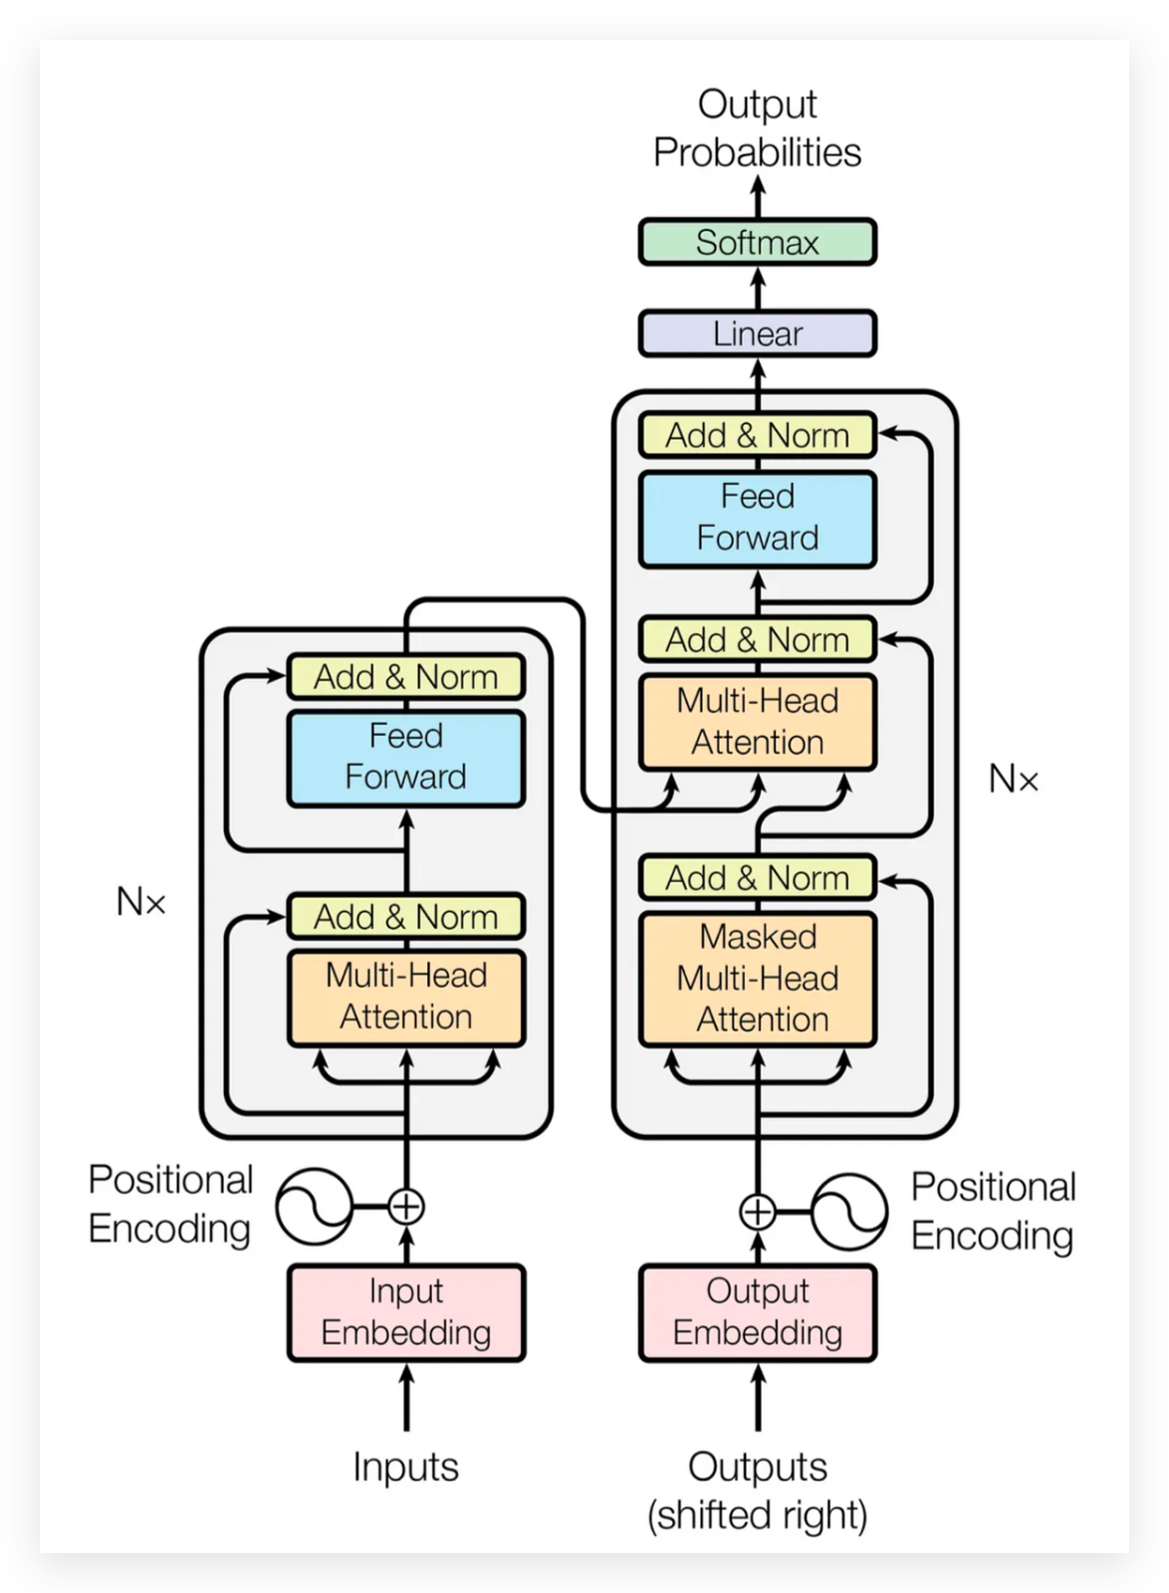
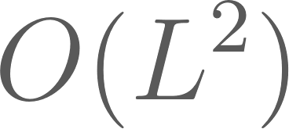
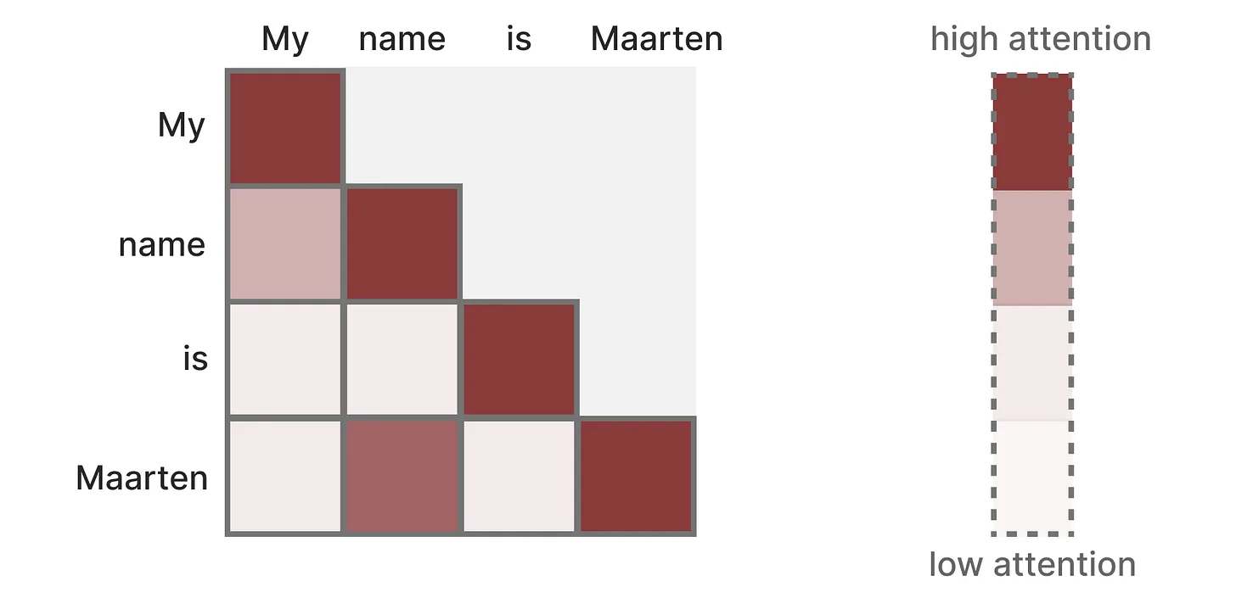
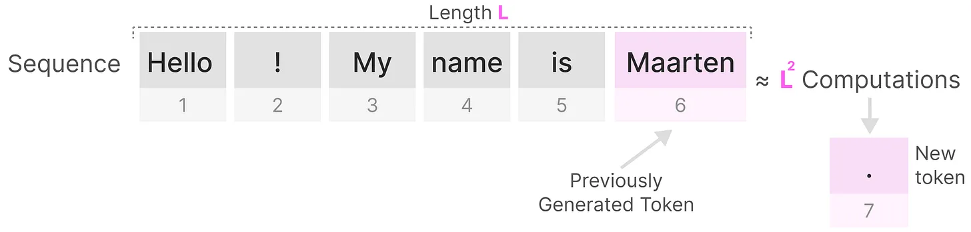
Transformers
Easy Parallel Training
See the sentence at once
Compute self-attention in parallel
Hard to Infer
Only generate one token at a time
Attention , every token looks at every other token

Slide 5
Part 2: State Space Models
Background
Reference:
Gu et al., "Efficiently modeling long sequences with structured state spaces" (2021).

Slide 6
What is a State Space?
Background
The state space contains the minimum number of variables (state variables) that fully describe a system.
Instead of looking back at every past input to make decision, the model only needs to look at current state

Slide 7
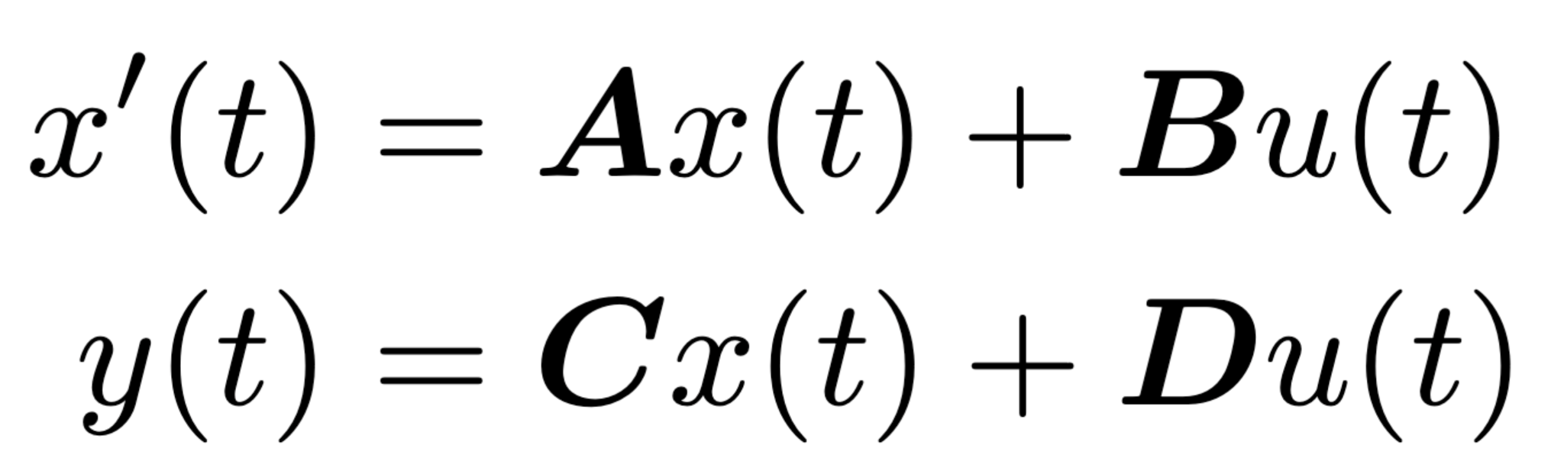
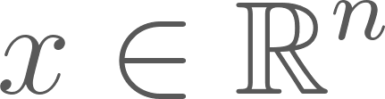
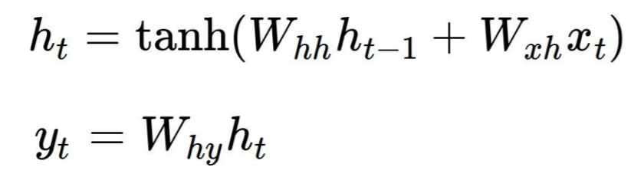
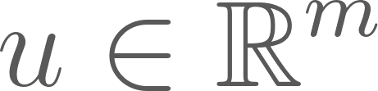

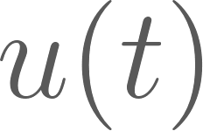
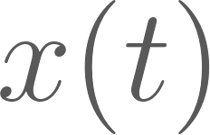
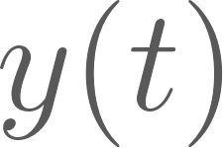




What is a State Space Model? (Continuous Form)
Background
RNN:
State variable
Input
Output
It maps a 1-D input signal to an N-D latent state and projects it to a 1-D output signal .
, , , are parameters learned by gradient descent.

Slide 8
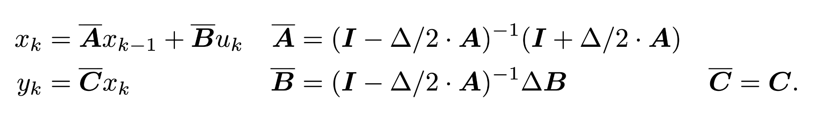

What is a State Space Model? (Discrete Form)
Background
This equation is now a sequence-to-sequence map instead of function-to-function.
This recurrent representation allows the discrete SSM to be computed like an RNN, enabling fast autoregressive inference.
But this is still sequential in training…

Slide 9
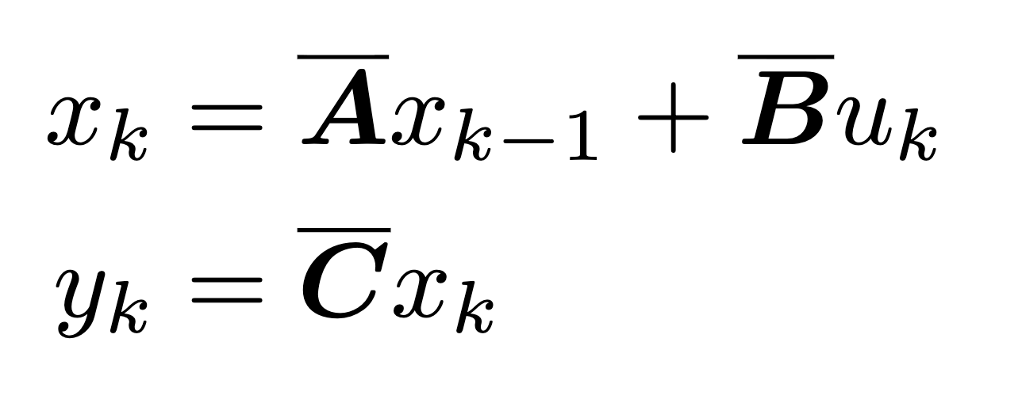
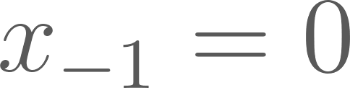
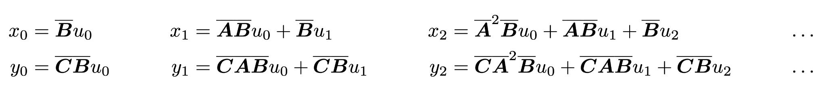
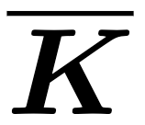
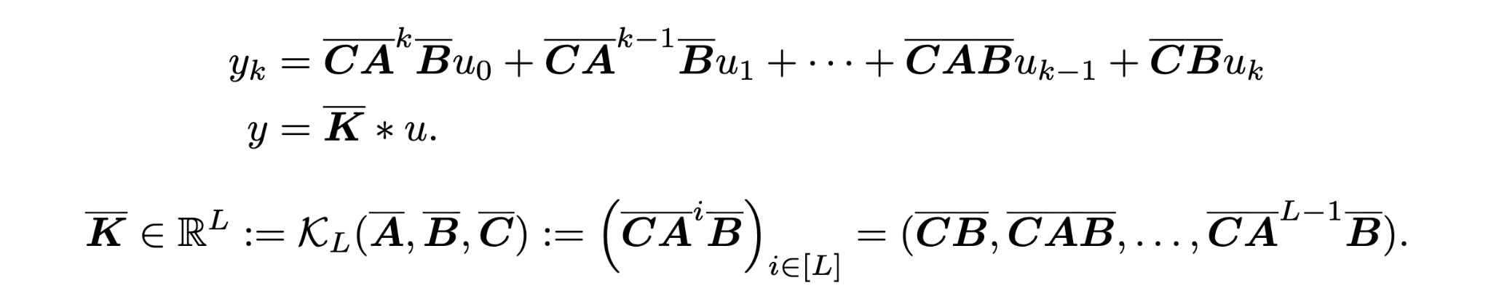
What is a State Space Model? (Convolution Form)
Background
Linear Time-Invariant System
Unrolling the discrete form yields: (assume )
This can be vectorized into a discrete convolution with kernel

Slide 10
What is a State Space Model? (Convolution Form)
Background

Slide 11

What is a State Space Model? (Convolution Form)
Background
This equation can be very efficiently computed with FFTs, provided that is known.
Complexity reduces from to
Why? Because Convolution Theorem states that:
Convolution in the time domain is equivalent to element-wise multiplication (cheap) in the frequency domain, enabling parallel training.

Slide 12
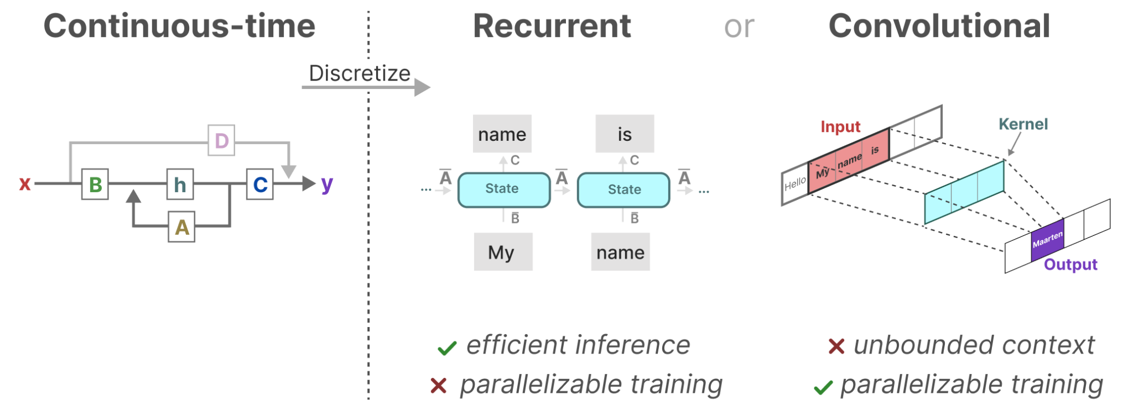
Background Summary
Background

Slide 13
Part 2: State Space Models
S4: Structured State Space Sequence model
Reference:
Gu et al., "Efficiently modeling long sequences with structured state spaces" (2021).
Gu et al., "Hippo: Recurrent memory with optimal polynomial projections." (2020)

Slide 14

The Importance of matrix
S4: Structured State Space Sequence model
It captures information about the previous states
It builds the new hidden state
However…, linear first-order ODEs have solutions involving the exponential function
Gradient scales exponentially
If eigenvalues slightly smaller than 0, signal vanishes
If eigenvalues slightly larger than 0, signal explodes
Unable to model long-range dependencies

Slide 15


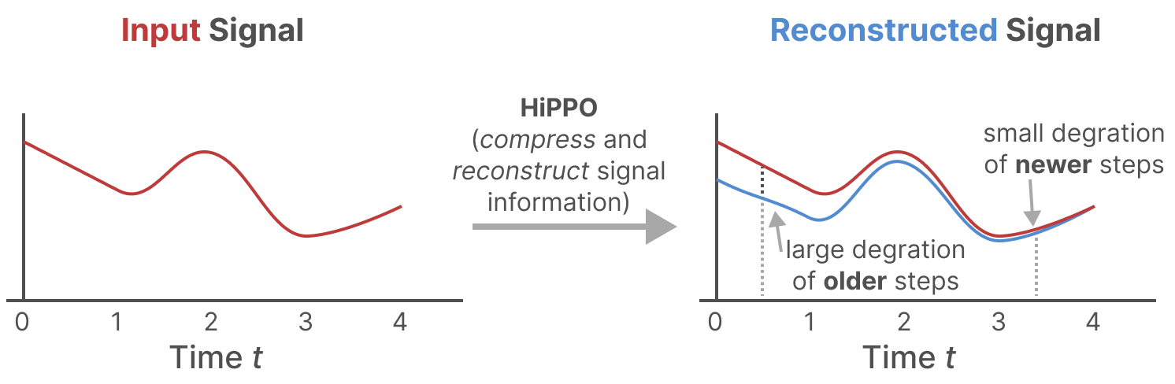
The HiPPO theory - Design Smartly
S4: Structured State Space Sequence model
HiPPO stands for High-order Polynomial Projection Operators.
Allows the state to memorize the history of the inputs

Slide 16
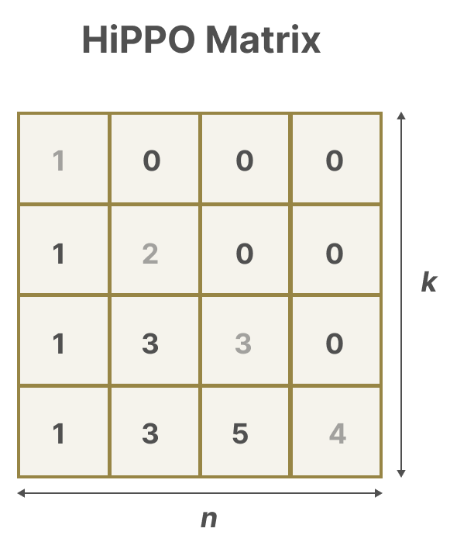
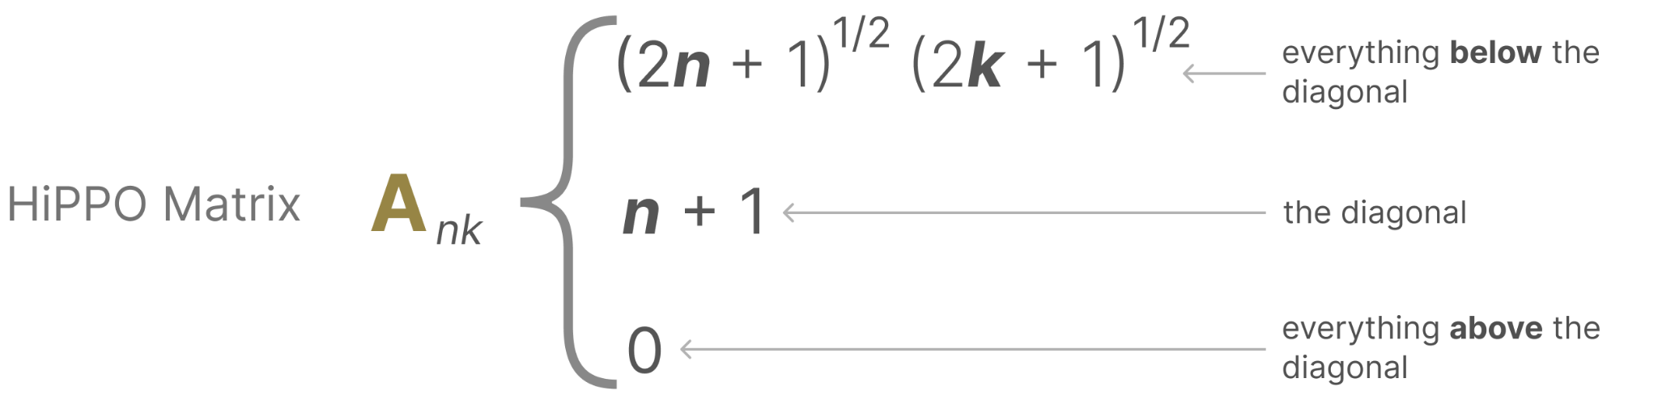
The HiPPO theory - Design Smartly
S4: Structured State Space Sequence model
Aims to optimally compress the input history signal into a fixed-size vector

Slide 17
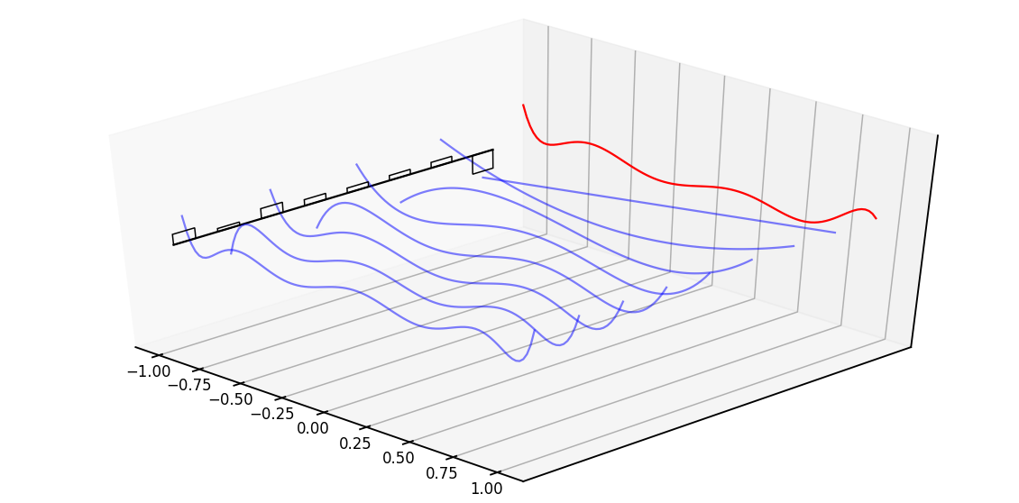
The HiPPO theory - Design Smartly
S4: Structured State Space Sequence model
The HiPPO matrix treats the state variables as coefficients of Legendre polynomials
Reference: https://srush.github.io/annotated-s4/
Notes:
The red line represents that curve we are approximating, while the black bars represent the values of our hidden state. Each is a coefficient for one element of the Legendre series shown as blue functions. The intuition is that the HiPPO matrix updates these coefficients each step.

Slide 18
The HiPPO theory - Design Smartly
S4: Structured State Space Sequence model
Takeaway:
In S4, HiPPO is used to initialize matrix in the state-space model. It ensures the model starts with the mathematical capability to memorize the input's history optimally.
This single design boosts accuracy on sequential MNIST from 60% to 98%
Notes:
The red line represents that curve we are approximating, while the black bars represent the values of our hidden state. Each is a coefficient for one element of the Legendre series shown as blue functions. The intuition is that the HiPPO matrix updates these coefficients each step.

Slide 19
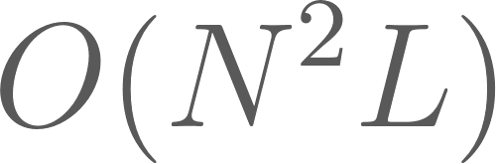
Diagonalization of
S4: Structured State Space Sequence model
Problem:
Computing naively involves L successive multiplication by , complexity
Notes:
The red line represents that curve we are approximating, while the black bars represent the values of our hidden state. Each is a coefficient for one element of the Legendre series shown as blue functions. The intuition is that the HiPPO matrix updates these coefficients each step.

Slide 20
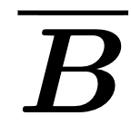

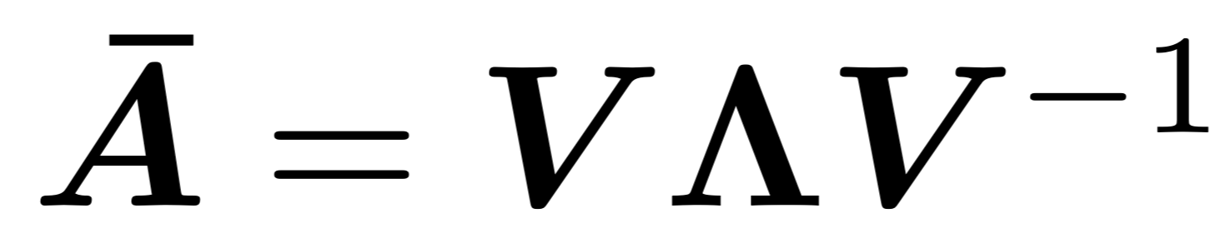
Diagonalization of
S4: Structured State Space Sequence model
Suppose we could diagonalize (assume and are vectors for single input):
, where denotes a diagonal matrix containing the eigenvalues of .

Slide 21
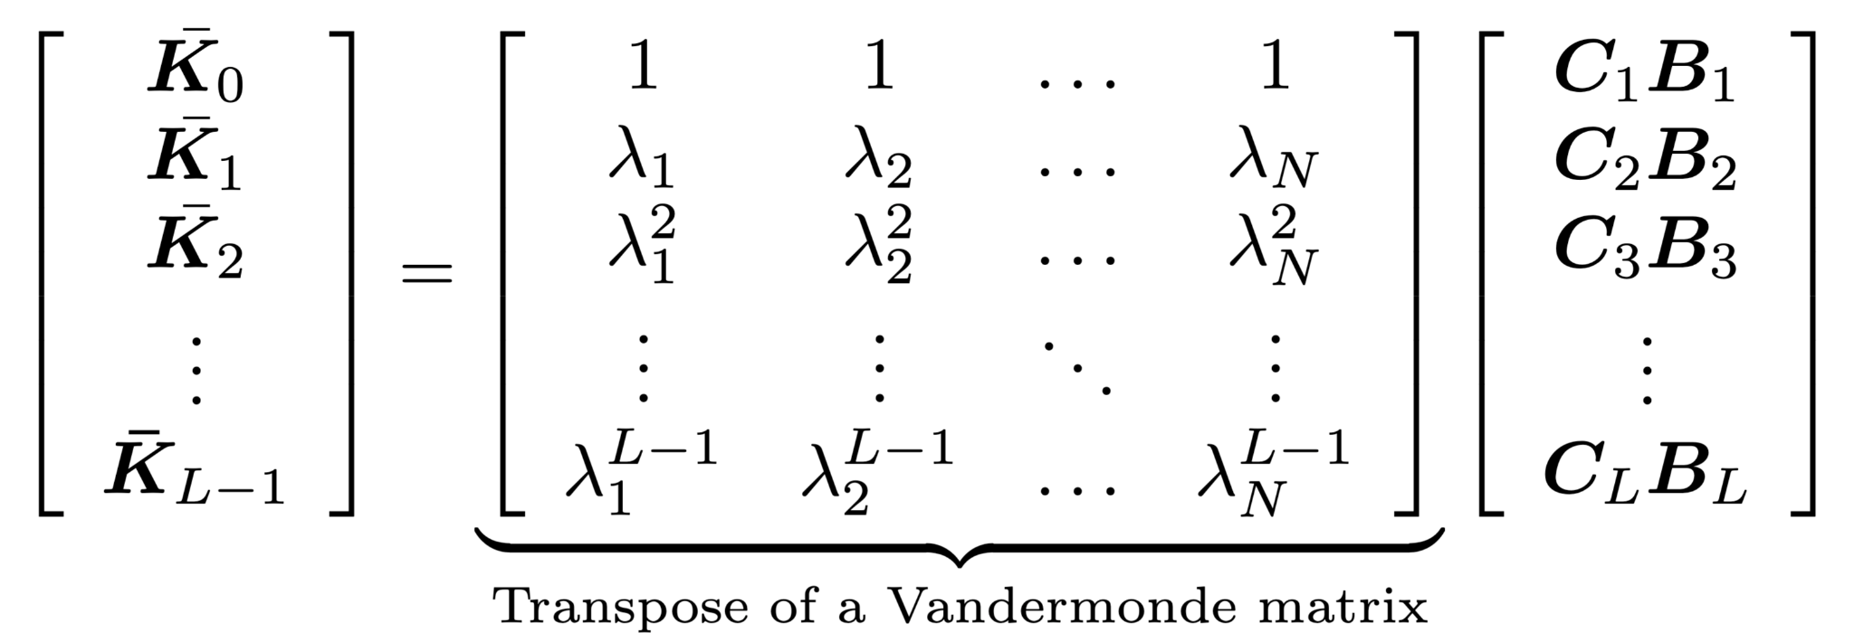
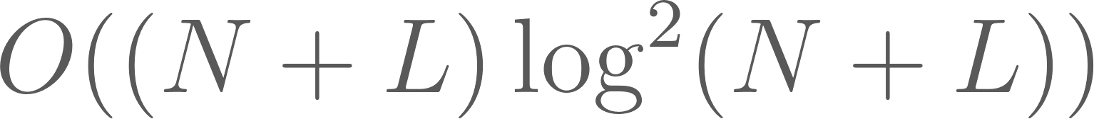
Diagonalization of
S4: Structured State Space Sequence model
Suppose we could diagonalize (assume and are vectors for single input):
,
Vandermonde product enjoys complexity.

Slide 22
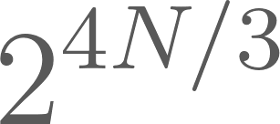
Diagonalization of
S4: Structured State Space Sequence model
However, the diagonalization of HiPPO matrix has entries exponentially large ( ), which renders numerical instability.
But, the HiPPO matrix can be decomposed into a normal matrix + a low rank matrix (NPLR). Instead of computing directly the powers of in the time domain, the authors calculate the generating function of kernel and evaluate the function at roots of unity. Then the kernel can be found by applying an inverse FFT.

Slide 23
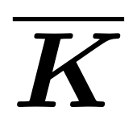
Diagonalization of
S4: Structured State Space Sequence model
Takeaway:
Despite not being normal, HiPPO matrix is NPLR, and authors prove that there is a nice and efficient way to compute the kernel from NPLR.

Slide 24
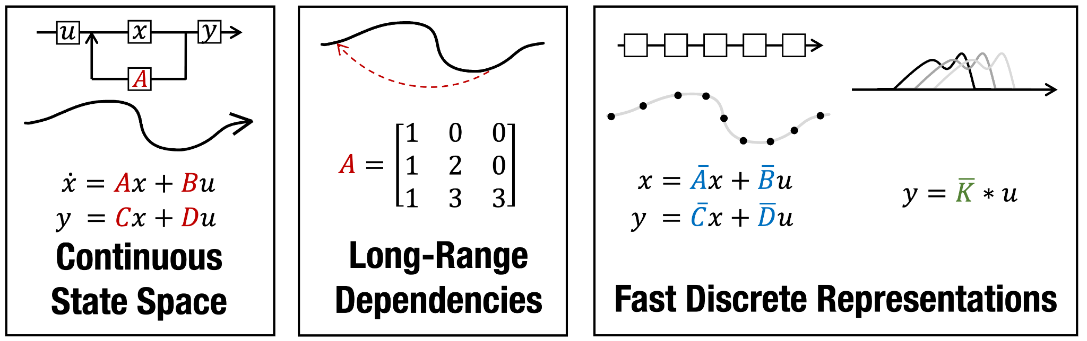
S4: Structured State Space Sequence model
This ends S4!

Slide 25
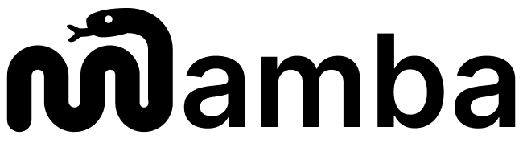
Part 2: State Space Models
Mamba: Selective State Space model
S6: Selective Scan Structured State Space Sequence Model
Reference:
Gu et al., “Mamba: Linear-time sequence modeling with selective state spaces” (2024).

Slide 26
What is the problem with S4?
Mamba: Selective State Space model
Linear time-invariant(LTI) is the reason why LTI SSMs enjoys recurrence and convolution properties.
S4 is a linear time-invariant(LTI) SSM.
Parameter , and are time-invariant, thus LTI SSM lacks the ability to focus on or ignore particular inputs

Slide 27
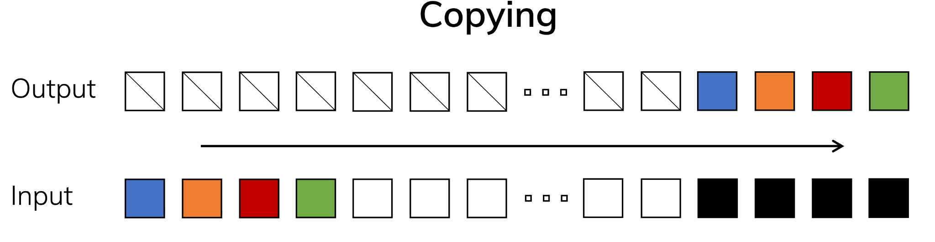
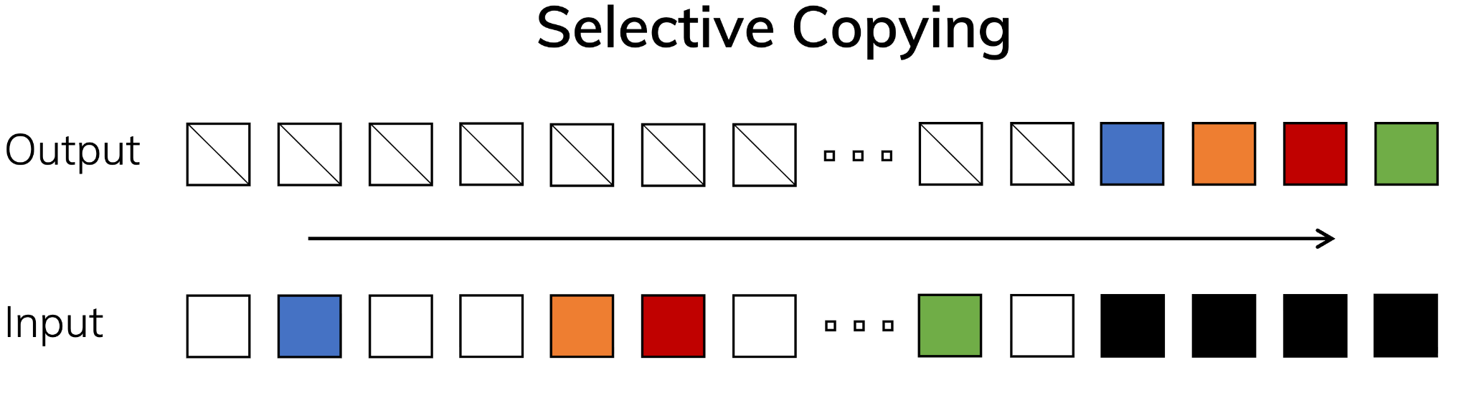
Selection as a Means of Compression
Mamba: Selective State Space model

Slide 28
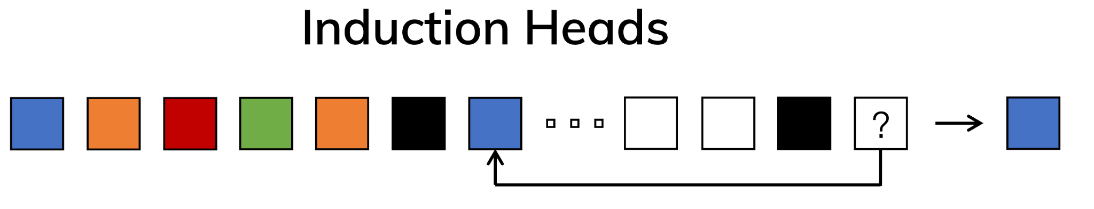
Selection as a Means of Compression
Mamba: Selective State Space model

Slide 29
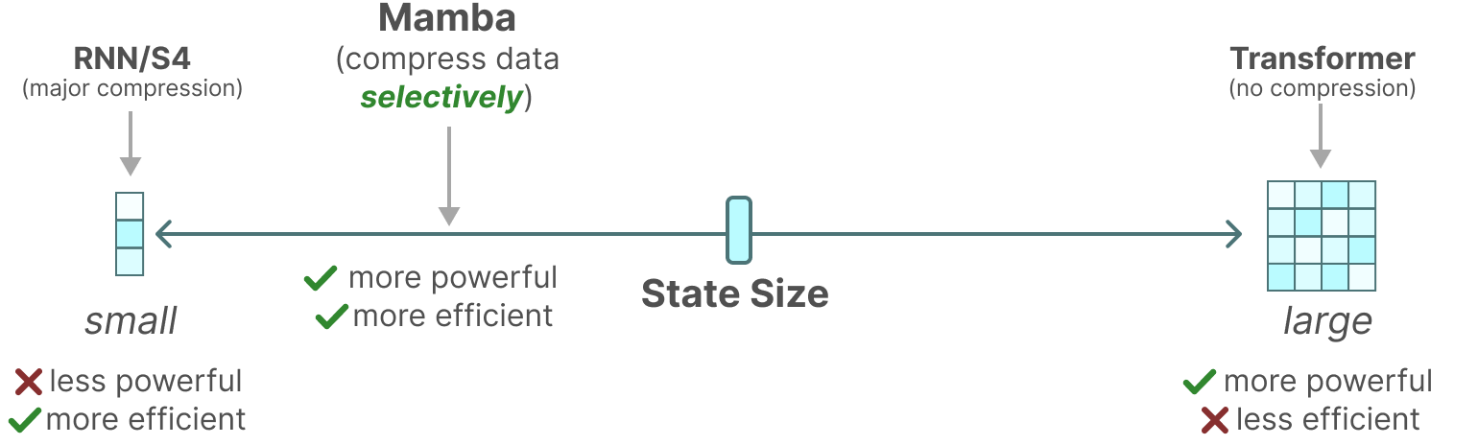
Selection as a Means of Compression
Mamba: Selective State Space model
A fundamental principle of building sequence models is selectivity.
Notes:
efficient models must have a small state, while effective models must have a state that contains all necessary
information from the context.

Slide 30
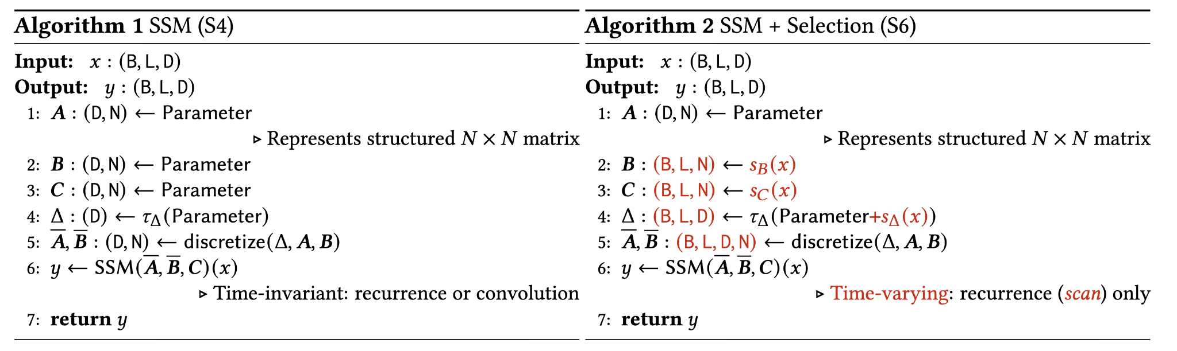
S4 vs. S6
Mamba: Selective State Space model
Notes:
efficient models must have a small state, while effective models must have a state that contains all necessary
information from the context.

Slide 31
Time-variant at What Cost?
Mamba: Selective State Space model
Mamba moves from LTI system to a time-variant system
Parameters are now dynamic, meaning they cannot be represented as convolution, and thus lost parallelization.
Parallel Scan comes to rescue

Slide 32
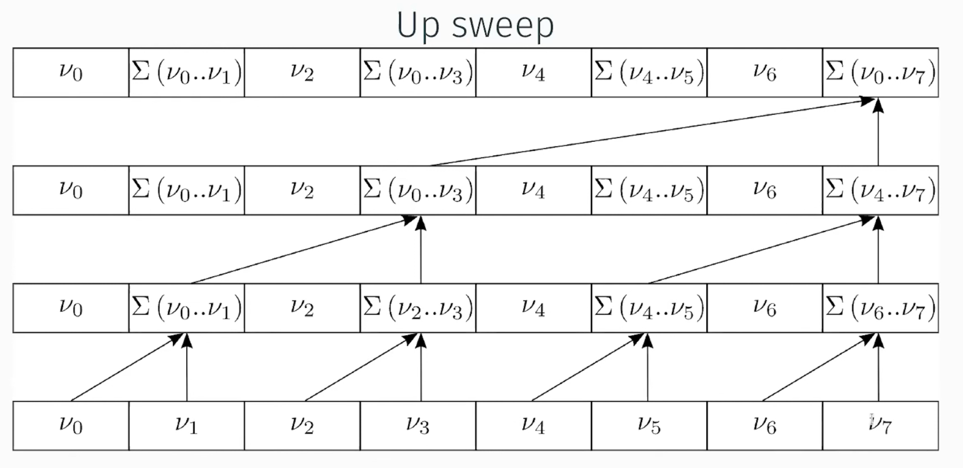
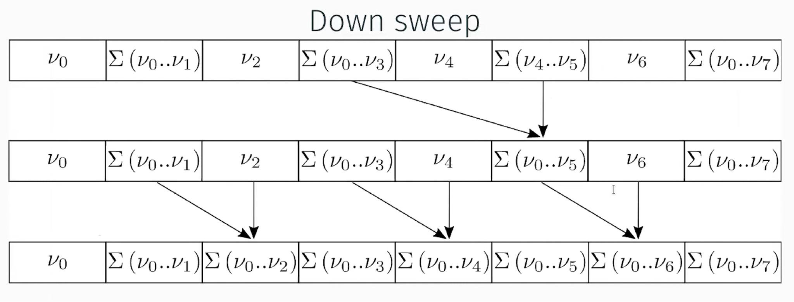
Parallel Scan
Mamba: Selective State Space model
Thankfully, SSMs are associative.
Mamba leverages GPU friendly parallel scan to make parallelizable training happen.

Slide 33
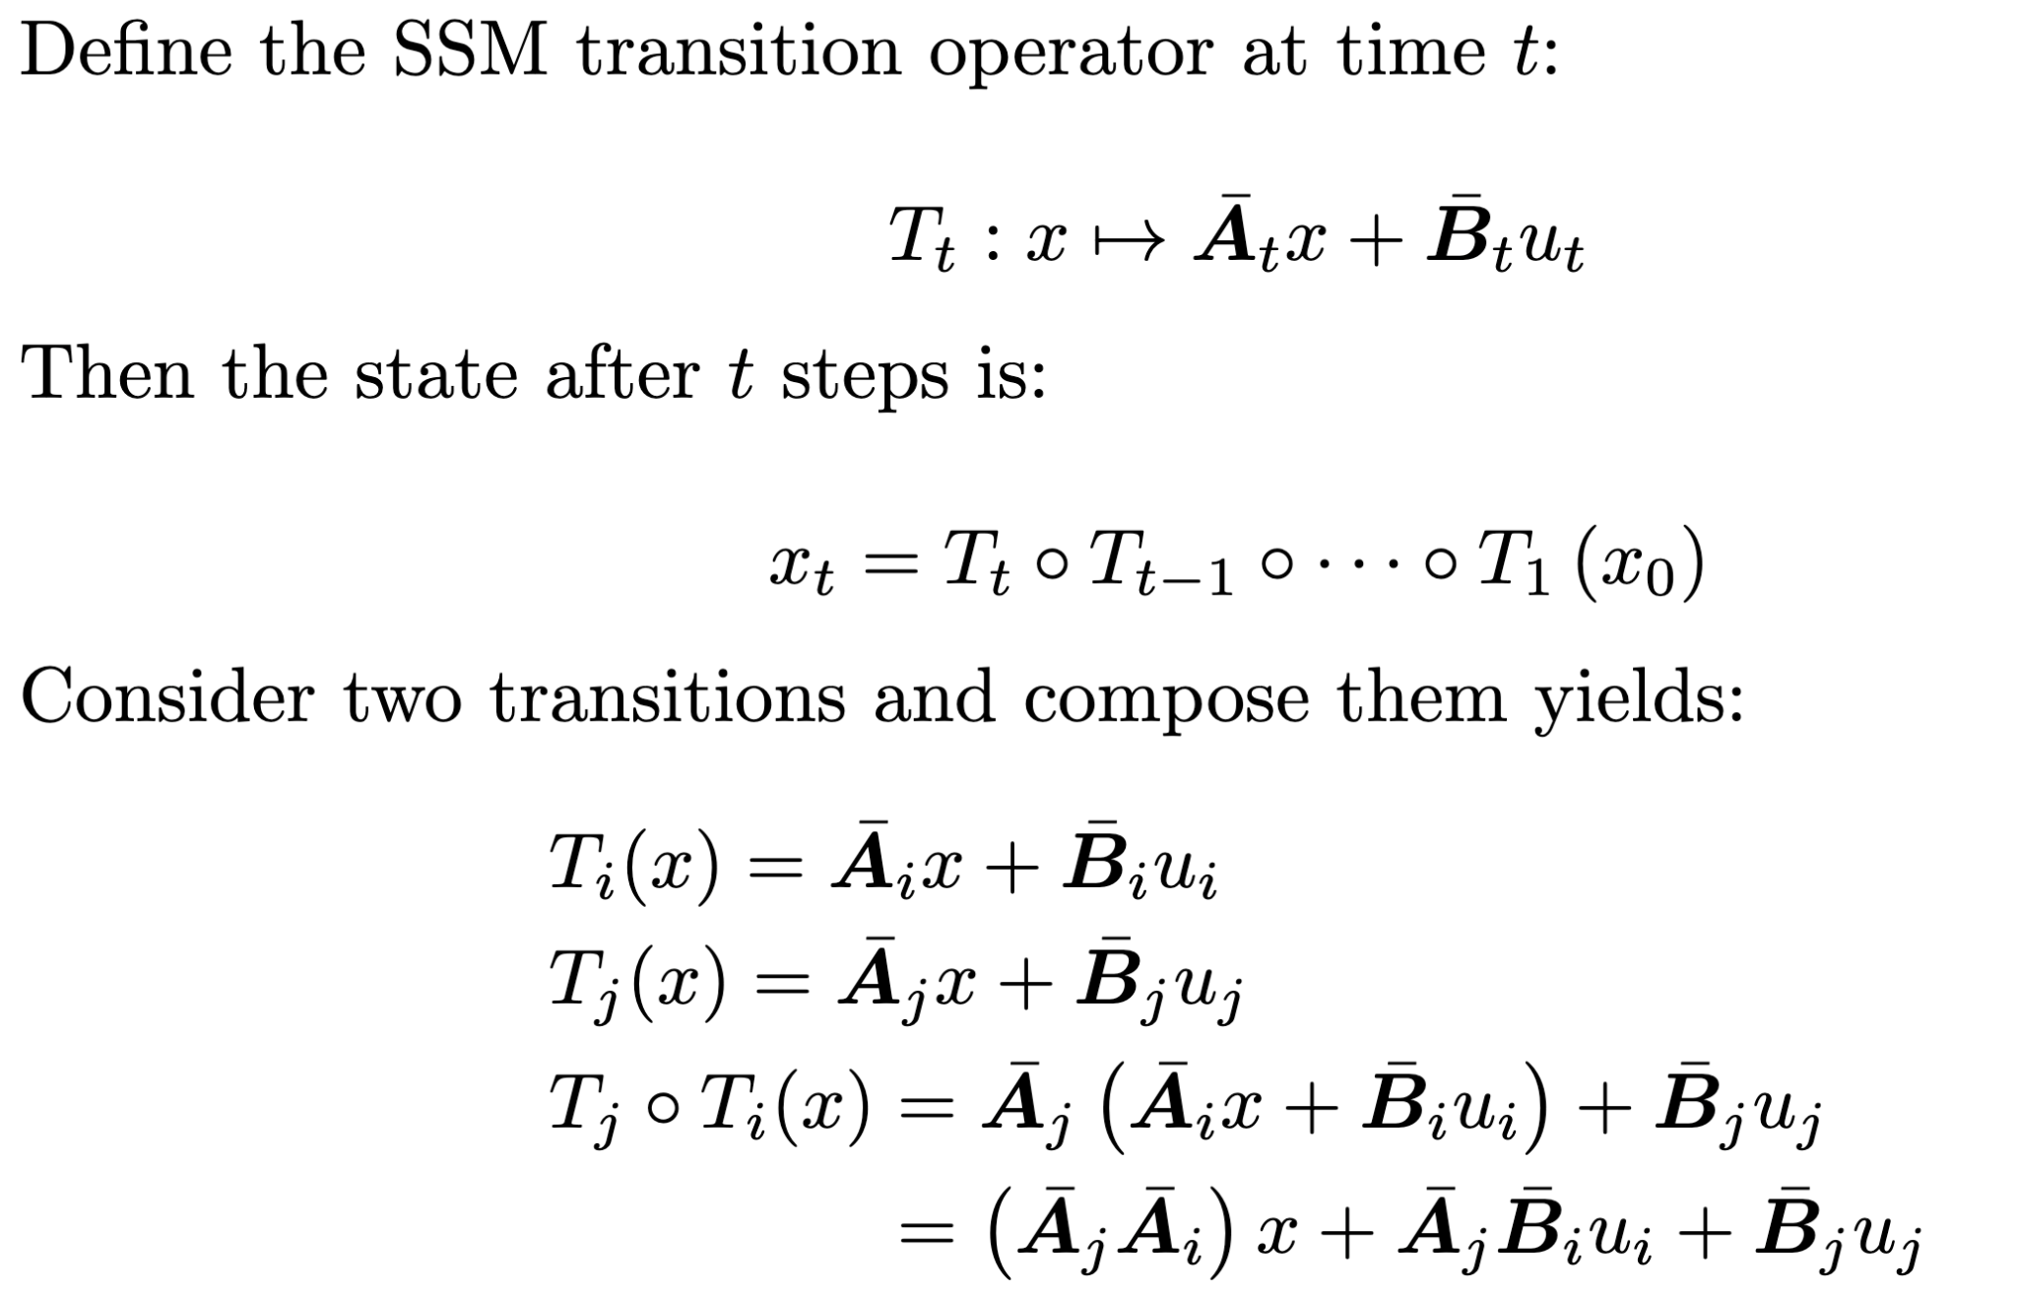
Parallel Scan
Mamba: Selective State Space model

Slide 34
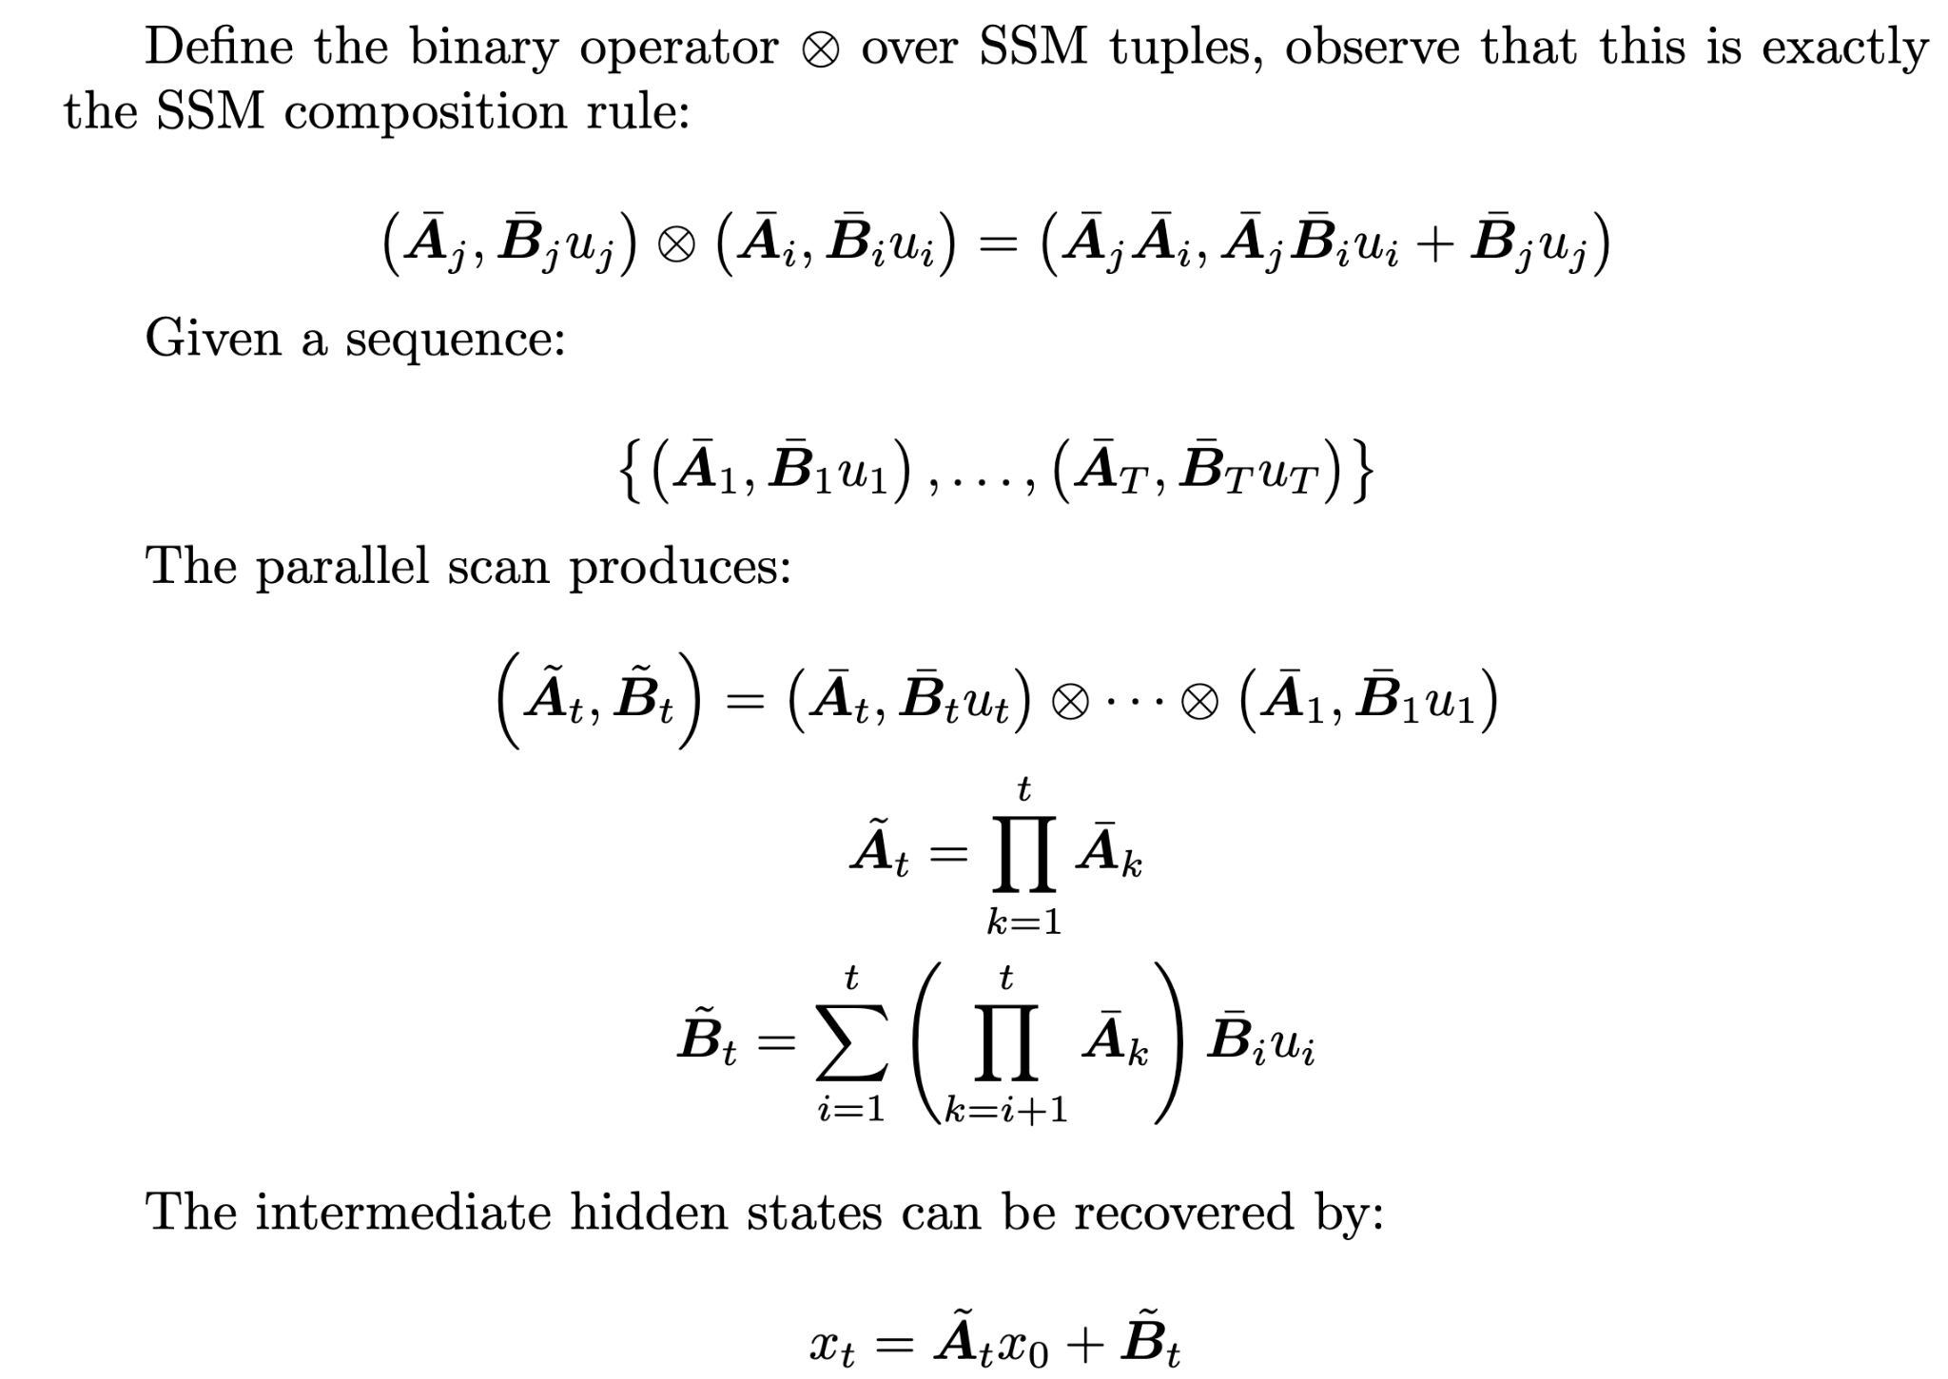
Parallel Scan
Mamba: Selective State Space model

Slide 35
Hardware-aware Algorithm
Mamba: Selective State Space model
Small but highly efficient SRAM
Large but less efficient DRAM
Frequently copying between SRAM and DRAM is the bottleneck
Mamba uses kernel fusion to prevent writing intermediate result into DRAM

Slide 36
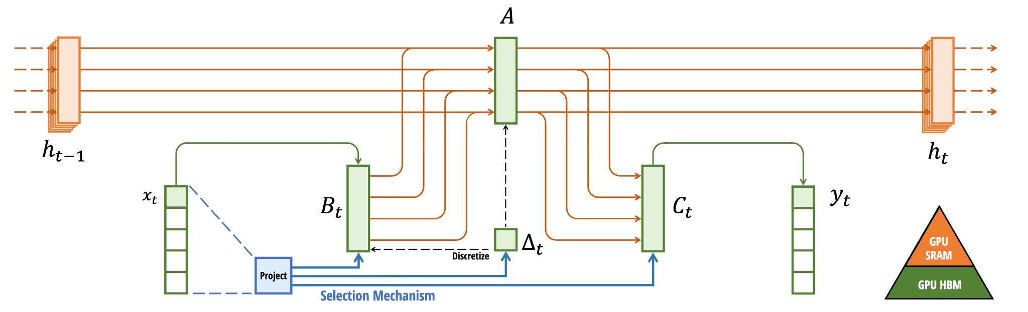
Overview
Mamba: Selective State Space model
This ends Mamba!

Slide 37
Part 3: SSM Applications
in Event vision
Reference:
Zubic et al. "State space models for event cameras." (2024)
Ren et al. "Rethinking efficient and effective point-based networks for event camera classification and regression: EventMamba." (2024)

Slide 38
Motivation
"State space models for event cameras"
State space models can be transformed into discrete-time system with arbitrary step size.
It permits inference at arbitrary frequencies.
Allows event-based vision to deploy at a different frequency from what it’s trained on during inference.
Notes:
If you train a Transformer on a drone flying at 10 m/s (generating events every 5ms), and then test it on a drone flying at 20 m/s (events every 2.5ms), the Transformer fails. It overfits to the specific "frame rate" of the training data.

Slide 39
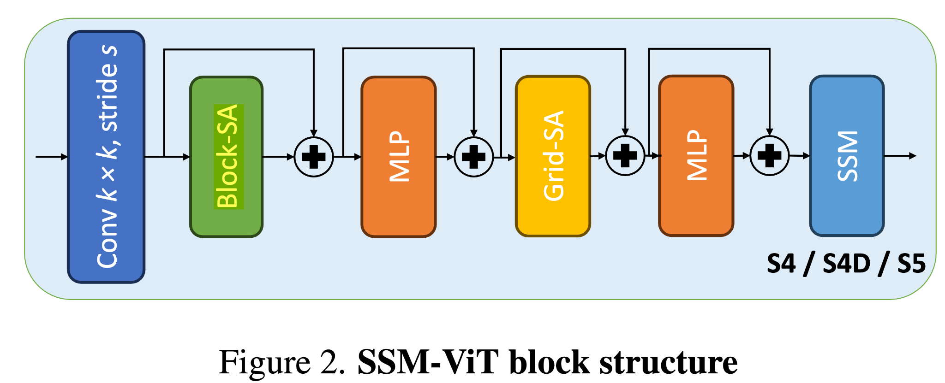
Architecture
"State space models for event cameras"
Notes:
If you train a Transformer on a drone flying at 10 m/s (generating events every 5ms), and then test it on a drone flying at 20 m/s (events every 2.5ms), the Transformer fails. It overfits to the specific "frame rate" of the training data.

Slide 40
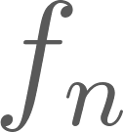
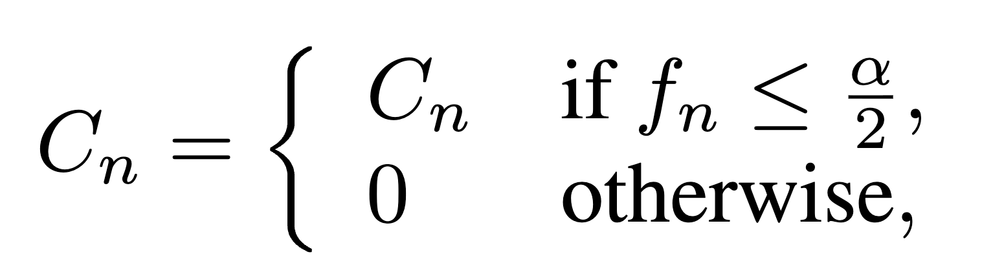
Low-pass Filter on
"State space models for event cameras"
Some states might be oscillating extremely fast. Frequency higher than the Nyquist frequency causes aliasing.
Solution: mask to kill states whose effective frequency is above a threshold:
Notes:
If you train a Transformer on a drone flying at 10 m/s (generating events every 5ms), and then test it on a drone flying at 20 m/s (events every 2.5ms), the Transformer fails. It overfits to the specific "frame rate" of the training data.

Slide 41
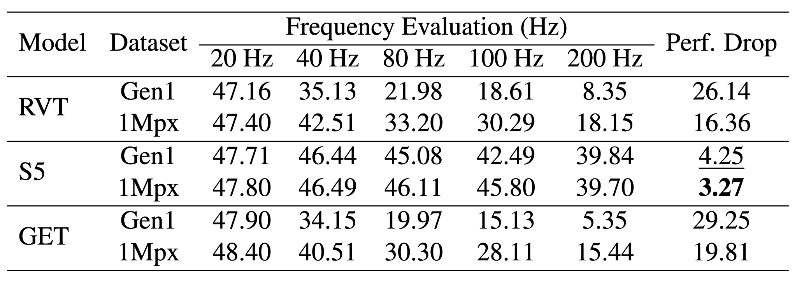
Performance with Different Testing Frequencies
"State space models for event cameras"
Notes:
If you train a Transformer on a drone flying at 10 m/s (generating events every 5ms), and then test it on a drone flying at 20 m/s (events every 2.5ms), the Transformer fails. It overfits to the specific "frame rate" of the training data.

Slide 42
Motivation
"EventMamba"
Notes:
If you train a Transformer on a drone flying at 10 m/s (generating events every 5ms), and then test it on a drone flying at 20 m/s (events every 2.5ms), the Transformer fails. It overfits to the specific "frame rate" of the training data.

Slide 43
Reference
https://www.ibm.com/think/topics/state-space-model
A Visual Guide to Mamba and State Space Models, https://newsletter.maartengrootendorst.com/p/a-visual-guide-to-mamba-and-state
State Space Models (S4, S5, S6/Mamba) Explained, https://www.youtube.com/watch?v=QJHA-PY8zDc
Making the Work-Efficient Parallel Prefix Sum Do Less Work, https://www.youtube.com/watch?v=1G8CZioSjnM
Introduction to State Space Models (SSM), https://huggingface.co/blog/lbourdois/get-on-the-ssm-train
The Annotated S4, https://srush.github.io/annotated-s4/

